Slide 1
TERMINOLOGY FOR FHIR IMPLEMENTATION GUIDES
Atlanta WGM
September 2019
Julie James PhD
Blue Wave Informatics LLP

Slide 2
Agenda
Introductions and Learning Objectives
[Healthcare] Terminology: what and why
Controlled Terminology Artefacts
Using Terminology in FHIR
Considerations for Code System selection
Considerations for Value Set definition

Slide 3
Who am I?
Julie is current chair of the HL7 Terminology Authority
Julie rides a red Harley Davidson motorbike
Julie is vocabulary facilitator for HL7 Biomedical Research and Regulation WG in HL7
Julie has spent the night in a builder’s skip in Exeter
Julie is a consultant to SNOMED CT
Julie has worked in the Brussels Red Light district
Julie has three children
Julie was the technical author of ISO 11615 IDMP for the European Medicines Agency
Julie would choose an evening working on datatypes against an evening walking on the beach

Slide 4
And who are you?
Are you Vocabulary Facilitators?

Slide 5
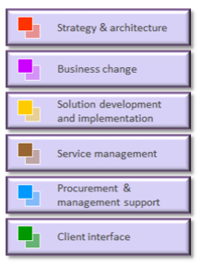
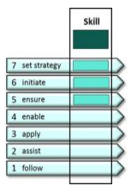
Learning….
Bloom’s Taxonomy of Education Objectives
Verbs used to describe the levels of tasks an individual at a given level of competency is able to perform:
Skills Framework for the Information Age Foundation (SFIA)
Used in IT recruitment and planning
Has “professional skills” organised in 6 categories
Each skill has 7 levels of attainment
Also has “behavioural skills”
Put all of this into a matrix to give a “professional profile” (e.g. “business analyst” or “information architect”)
Knowledge | Arrange, define, duplicate, label, list, memorize, name, order, recognize, relate, recall, repeat, and reproduce state
Comprehension | Classify, describe, discuss, explain, express, identify, indicate, locate, report, restate, review, select, translate, understand
Application | Apply, choose, demonstrate, dramatize, employ, illustrate, interpret, operate, practice, schedule, sketch, solve, use, write
Analysis | Analyse, appraise, calculate, categorize, compare, contrast, criticize, differentiate, discriminate, distinguish, examine, experiment, question, and test
Synthesis | Arrange, assemble, collect, compose, construct, create, design, develop, formulate, manage, organize, plan, prepare, propose, set up, and write
Evaluation | Appraise, argue, assess, attach, choose compare, defend estimate, judge, predict, rate, score, select, support, value, evaluate

Slide 6
Put them together:
Knowledge | Arrange, define, duplicate, label, list, memorize, name, order, recognize, relate, recall, repeat, and reproduce state | 1. Follow
Comprehension | Classify, describe, discuss, explain, express, identify, indicate, locate, report, restate, review, select, translate, understand | 2. Assist
Application | Apply, choose, demonstrate, dramatize, employ, illustrate, interpret, operate, practice, schedule, sketch, solve, use, write | 3. Apply
Analysis | Analyse, appraise, calculate, categorize, compare, contrast, criticize, differentiate, discriminate, distinguish, examine, experiment, question, and test | 4. Enable
Synthesis | Arrange, assemble, collect, compose, construct, create, design, develop, formulate, manage, organize, plan, prepare, propose, set up, and write | 5. Ensure, advise 6. Initiate, influence
Evaluation | Appraise, argue, assess, attach, choose compare, defend estimate, judge, predict, rate, score, select, support, value, evaluate | 7. Set strategy, inspire, mobilise

Slide 7
For writing FHIR IGs…
the requirement is to be about here in the matrix:
Application | Apply, choose, demonstrate, dramatize, employ, illustrate, interpret, operate, practice, schedule, sketch, solve, use, write | 3. Apply
Analysis | Analyse, appraise, calculate, categorize, compare, contrast, criticize, differentiate, discriminate, distinguish, examine, experiment, question, and test | 4. Enable
Synthesis | Arrange, assemble, collect, compose, construct, create, design, develop, formulate, manage, organize, plan, prepare, propose, set up, and write | 5. Ensure, advise 6. Initiate, influence
Please note that this is quite a way ‘into’ the learning matrix, and requires not just training, but a lot of practice. Not necessarily Gladwell’s ‘10,000 hours’ but certainly more than a 3 hour tutorial ☺

Slide 8
Learning Objectives
Being confident of the basic principles of terminology in healthcare to be able to apply it effectively (in implementation guidance for) systems
Concepts, Code systems and Value sets
What they are, how they fit together
How to use and identify/reference them
Having understanding of the considerations for code system selection for implementation guidance – which terminologies to choose and why
Having understanding of the considerations for value set management – the when, how and why of using value sets

Slide 9
Not in scope….sorry!
An explanation of the full CLD for a value set
Terminology mapping
Use of terminology services/servers

Slide 10
Questions?
What’s more important – the code system or the value set?
Is an extensionally defined value set better than an intensionally defined value set?
Should we allow free text instead of a coded concept?
Which is the best binding strength to use?
Do you have a favourite “Cimino desideratum”?

Slide 11
[HEALTHCARE] TERMINOLOGY – WHY and WHAT

Slide 12
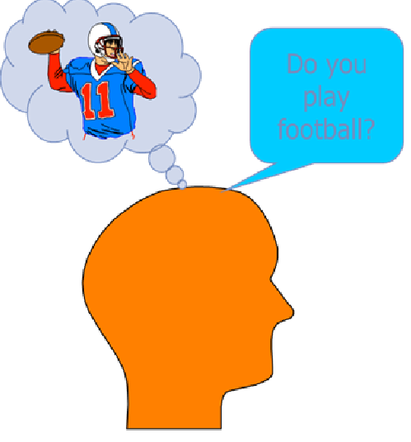
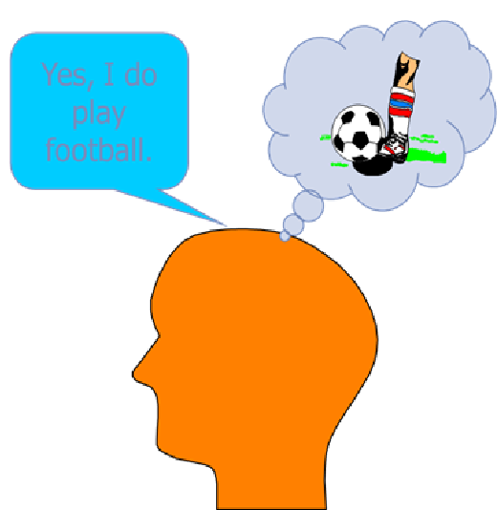
Sharing data meaningfully:

Slide 13
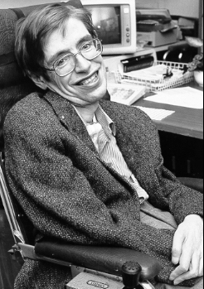

Computers are worse than humans!
Computers can’t really think intuitively – even with AI; they generally only do pattern recognition (machine learning)
SCTID: 37340000
Controlled terminology, when used properly, allows us to express meaning in a way that can always be understood over space and time

Slide 14
Why bother with terminology?
Just use text
Usually too rich, too nuanced, too much
Hard to fit correctly into an info model without duplication
In a product label: Special warnings and precautions for use:
“….all patients should be screened for latent tuberculosis (TB) infection prior to starting Tocilizumab therapy. Patients with latent TB should be treated with standard anti-mycobacterial therapy before initiating Tocilizumab…..”
Should this be in the contra-indication section for Tocilizumab, or the warning section or BOTH?
Even with newer techniques, it’s hard to analyse large volumes of data
Suicidal ideation in adolescents with SSRI

Slide 15

Clouds and Mountains*
Nothing is as certain but Death and Taxes** ….
AND CHANGE
Moving mountains is complex and expensive
Clouds are designed to move
Terminology is designed to manage change in an organised and governanced manner – it’s important to remember that when using terminology in IGs
* Lisa Nelson, MaxMD
** Daniel Defoe, in The Political History of the Devil, 1726

Slide 16
What is Terminology?
“Terminology” is the study of terms and their use — of words and compound words (phrases) that are used in specific contexts (domains)
“Terminology” also describes a formal discipline which systematically studies or practices the description and organisation of concepts in a domain (subject area) for one or more uses
the product of this process is called “a systematic terminology” or (in the pharma domain) “controlled terminology”
The folk who do this stuff are therefore called “terminologists” ☺

Slide 17
Terminology Fundamentals:
Analysis and description/definition of the concepts (“units of thought”) within the particular domain
Analysis and description of the relationships between the concepts (the organisation between the terms)
Identification of all the terms (words or phrases) associated with a concept (synonyms)
[Providing codes for machine processing of concepts]
Please note: to do this well is not cheap. Terminology costs, even if you are not paying directly. Please be respectful of that when writing your IGs.

Slide 18
A Terminology is…
The product of applying the principles of terminology to create “a body of terms* used with a particular technical application in a subject of study, theory, profession etc.”
A terminology has aspects of a dictionary (explaining concepts) and taxonomy/classification (organising the concepts – structure – relationships between concepts)
Examples (in healthcare):
SNOMED CT
LOINC
ICD-10
NCI Thesaurus
* Because the “terms” are words or phrases, this is often also referred to as “controlled vocabulary”

Slide 19
Is this really use Terminology?
Or should it be “master data”?
What is the difference?
The resource definition should have this clear, but check ☺

Slide 20
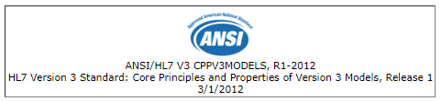
Controlled Terminology Artefacts
Concepts and concept representation
Code systems
Value sets

Slide 21


Concept – a “unit of thought”
A unitary mental representation of a real (like “pneumonia”) or abstract (like “love”) thing – an atomic unit of thought
Concepts are abstract, language- and context-independent representations of meaning
With thanks to David Robinson - NHSIA

Slide 22
A concept can be labelled with a code
735215001

Slide 23
Code: Definition and Description
A Code is a machine processable Concept Representation published by the author of a Code System as part of the Code System
It is the preferred (unique) identifier for that concept in that Code System for the purpose of communication between systems (preferred machine-readable concept representation)
Codes are sometimes meaningless identifiers, and sometimes they are mnemonics that imply the represented concept to a human reader.
MedDRA code – has meaningless identifiers – “10040589” (Shoplifting)
ISO (2 letter) Country codes – mnemonic – GB = Great Britain
Meaningless identifiers are advised particularly in larger vocabulary systems

Slide 24
A concept can be labelled with one or more designations
“Apple”
“Pomme”
“Manzana”

Slide 25
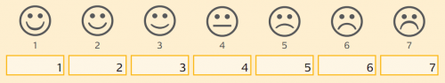
A concept can be labelled with one or more symbols
This used to be fairly rare, but is not now….Think icons and emoticons:

Slide 26
Designation: Definition and Description
A Designation is a human consumable representation of a concept
It is intended to convey the concept meaning to a human being
A Designation may also be known as an appellation, symbol, display name or term
A Designation could be a string of characters (but could also be multimedia); it is generally subject to language variants
A concept may have several designations; e.g. a long (full) display name, a short display name, a preferred term and synonyms

Slide 27
Concept representation:
A Concept Representation is a vocabulary object that enables the description and manipulation of a Concept in systems and applications (such as information models, xml/json schema (such as FHIR schema), databases, SAS data files)
In a code system, any one concept will have 1..* concept representations
usually at a minimum at least one “code” and at least one “designation”

Slide 28
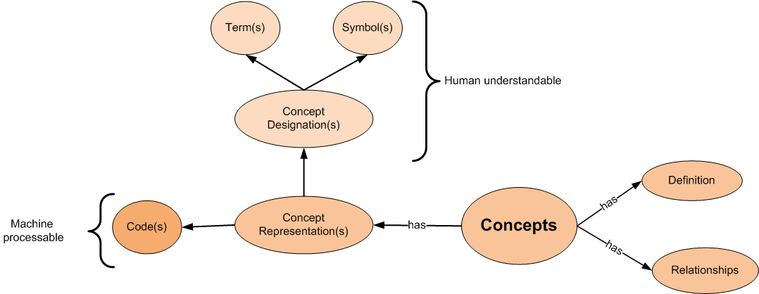
The basic “terminology model”:

Slide 29

Code Systems
Collections of concepts with their representations

Slide 30
Code System : Definition and Description
A Code System is a managed collection of Concept Representations, including codes and/or designations, but sometimes with more complex sets of rules, references (definitions), and relationships∗
A Code System may be described as “a collection of uniquely identifiable concepts with associated representations, designations, associations, and meanings”
A Concept should be unique in a given Code System
A concept may have synonyms
A concept maybe a singleton, or may be constructed of other concepts (i.e. post-coordinated concepts)
Best practice has each concept with one unambiguous preferred term and any number of synonyms (note: synonyms may be shared with other concepts)
Although these things may be differentially referred to as terminologies, vocabularies, or coding schemes, or even classifications, all such collections are ‘Code Systems’

Slide 31
Code System Properties
Code systems should have:
a description consisting of prose that describes the Code System, and may include the Code System uses, maintenance strategy, intent and other information of interest
when using a code system to support instantiation of a model, it is this description that should match or be compatible with the relevant concept domain
administrative information proper to the Code System, independent of any specific version of the Code System, such as ownership and copyright information

Slide 32
Code system

Slide 33
Code System Identification in FHIR
This is the identification used in the “system” attribute of the Coding and CodeableConcept data types (more of this later)
FHIR states “choice of the correct URI for the system attribute is critical”
Unfortunately, this is easier said than done

Slide 34
Ordered List for Code system identification
The specification Code System Registry - if a code system is listed here, it SHALL be used
A system URI or OID defined as the correct value to use in FHIR by the publisher of the code system
The FHIR community code system registry - if a code system is listed here with status = active, it SHALL be used
An OID registered in the HL7 OID registry - if a code system is registered here, the OID SHOULD be used (using the syntax urn:oid:[oid])

Slide 35
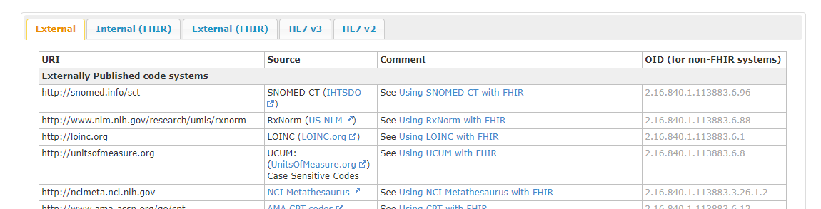
FHIR Code System Registry
https://www.hl7.org/fhir/terminologies-systems.html
Contains information about non-HL7 code systems (under the “External” tab and HL7 or FHIR managed code systems (under the other 4 tabs)
The provenance of this information appears to be the Vocabulary WG

Slide 36
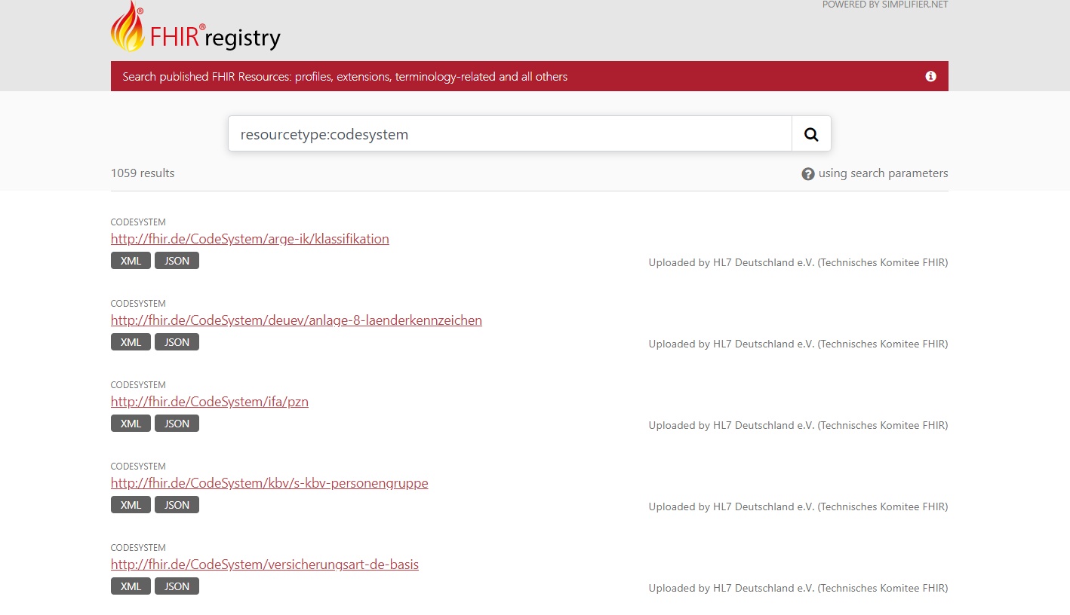

FHIR Community Code System Registry
https://registry.fhir.org/search?q=resourcetype:codesystem

Slide 37
Managing Change in Code Systems
Code System content should evolve over time
Changes occur because of
corrections and clarifications
the understanding of the concepts being described evolves (e.g., new genes and proteins are discovered)
the concepts being described change (e.g., new countries emerge; old countries are absorbed)
the assessment of the relevance of particular concepts within the knowledge resource change (e.g., the addition of new parent-child relationships)

Slide 38
Code System Versions
Depending upon how well the Code System adheres to Good Vocabulary Practices (the “Cimino Desiderata”), changes could be significant
Changes in concept meaning – although discouraged – can occur and can cause issues which could themselves be significant
Therefore it can important to know (and therefore to specify in guidance) which version of a given Code System is to be used in any implementation

Slide 39
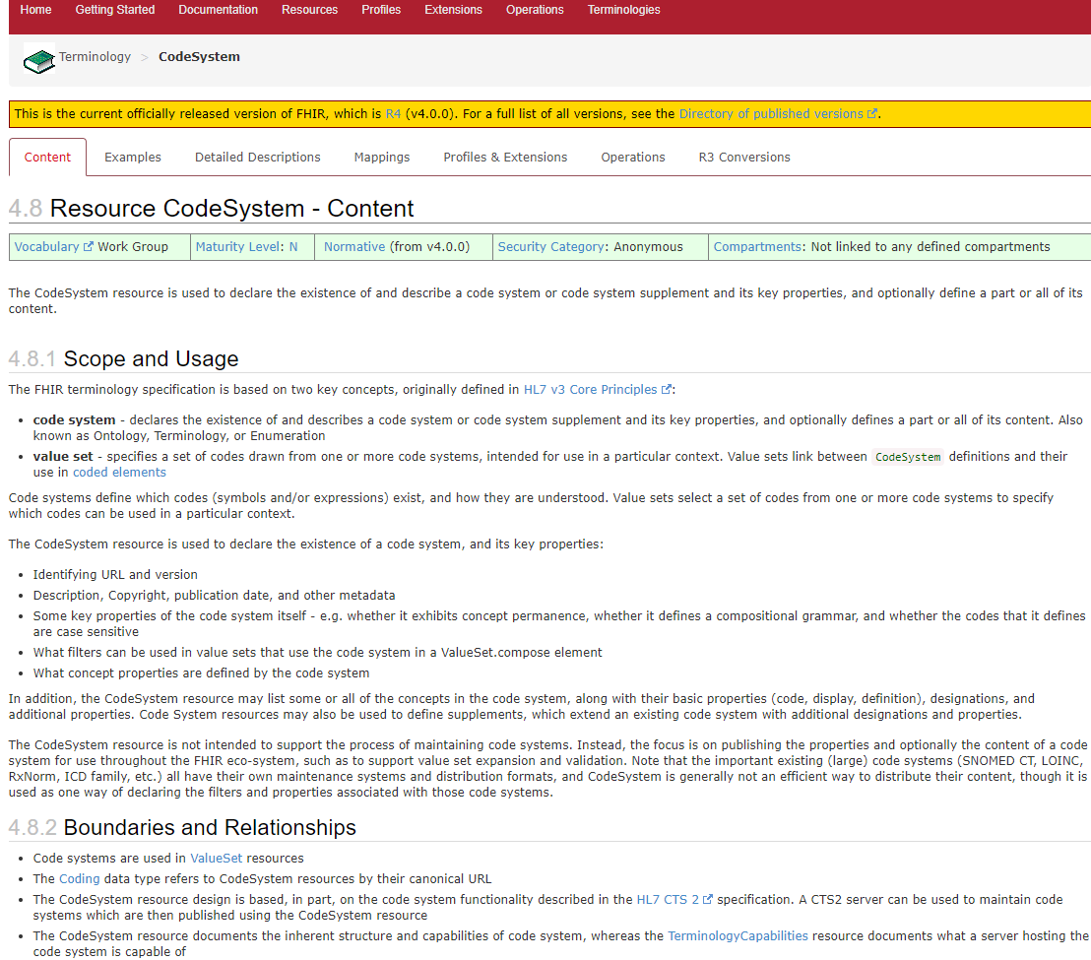
FHIR Code System Resource (I)
https://www.hl7.org/fhir/codesystem.html
Used to “declare the existence of and describes a code system…and its key properties” (i.e. its main metadata)
and optionally defines a part or all of its content

Slide 40

FHIR Code System Resource (II)
Identifying URL and version
Description, Copyright, publication date, and other metadata
Some key properties of the code system itself - e.g. whether it exhibits concept permanence, whether it defines a compositional grammar, and whether the codes that it defines are case sensitive
What filters can be used in value sets that use the code system in a ValueSet.compose element
What concept properties are defined by the code system
In addition, the CodeSystem resource may list some or all of the concepts in the code system, along with their basic properties (code, display, definition), designations, and additional properties. Code System resources may also be used to define supplements, which extend an existing code system with additional designations and properties.
This possibly risks making the code system resource a little schizophrenic as it is trying to do two things, one mandatory, one optional and with the ability to extend beyond what the code system as managed by the code system owner provides ☹

Slide 41
Value sets:

Slide 42
Value set use
A value set makes the link between the codes in (one or more) code systems and the coded attributes in a model (or elements in a FHIR resource)
It is the value set that makes a particular coded attribute “conformance testable” in a model or schema
Therefore, it is the value set that is vital in Implementation Guidance…

Slide 43
Value Set: Definition
A Value Set represents a uniquely identifiable set of valid concept identifiers where any concept identifier used in a coded element can be tested to determine whether it is a member of the Value Set at a specific point in time
Value Sets exist to constrain the permissible content of a concept domain for a particular use
in an information model vocabulary binding
in analysis
in UI data collection - in a pick list (drop-down box), etc.
as query parameters

Slide 44
Value set content
Is delineated by a value set definition
See the HL7 Value Set Definition standard
http://www.hl7.org/documentcenter/private/standards_temp_E71BBB95-1C23-BA17-0CEAEF23E6F7F4B0/HL7_SPEC_VSD_R1_2019MAR.pdf
Is expressed by a value set expansion
The full enumerated list of concepts (codes) that are valid for the value set at a point in time

Slide 45
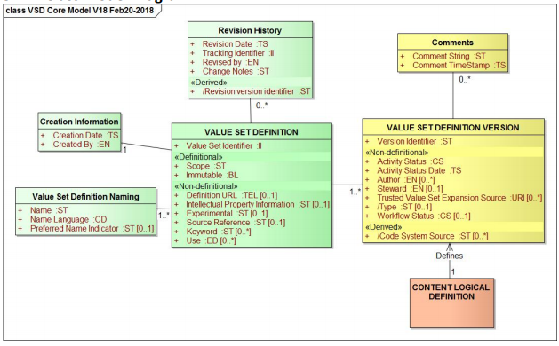
Value set definition: its metadata

Slide 46
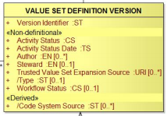
Value Set Type
Computable (intensional) – algorithmically defined
And therefore can be dynamically updated – remember terminology exists partly to manage things that change a lot
Usually requires a terminology server to give the expansion
Enumerated (extensional) – a list that is managed directly (the enumeration is the expansion)
More constrained/controlled, but likely to need maintenance (depending on whether it is “locked” to a code system version)

Slide 47
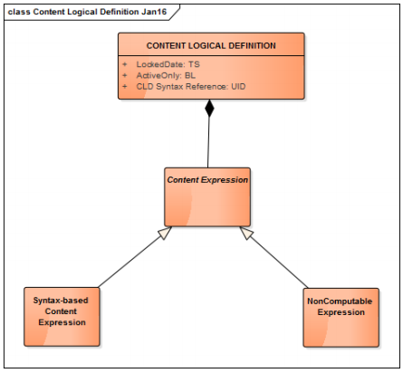
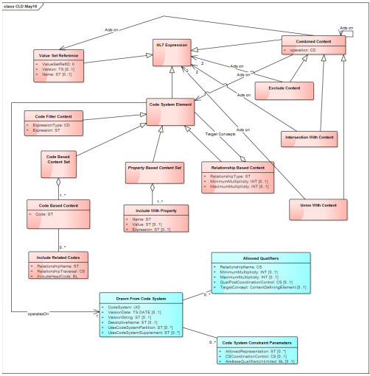
Value set definition: Content Logical Definition (CLD)
It’s a whole class to go through this; it’s the full principles of value set definition – so if you are not familiar with it, it would be wise to get familiar with it!

Slide 48
Value set identification (in FHIR)
ValueSet.id: the logical id on the system that “holds” the value set (present in the Domain Resource)
this changes as it moves from [terminology] server to [terminology] server (this id, with the server address prepended, is called the 'literal identity' of the resource)
it is a (local) ID to reference the value set
ValueSet.url: the canonical URL that never changes for this value set - it is the same in every copy.
this should be a literal URL (a URI) that is the location of the master version of the value set, though this is not always possible
this is used in the binding syntax (see below)
ValueSet.identifier: Can contain (for example a system/value pair that is used to identify the value set in other contexts (such as an OID in an HL7 v3 specification)

Slide 49
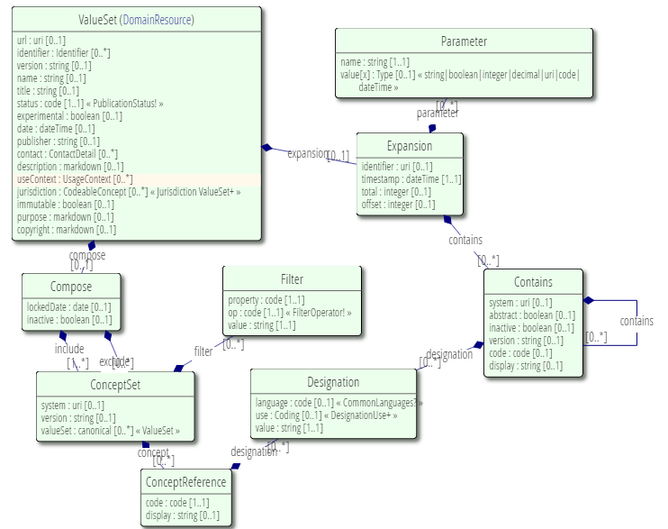
The FHIR Value set resource
A complex resource based on the CLD:
Not likely to be used in written IGs in this format, but would be used to make the value set definition communicable using a FHIR resource

Slide 50
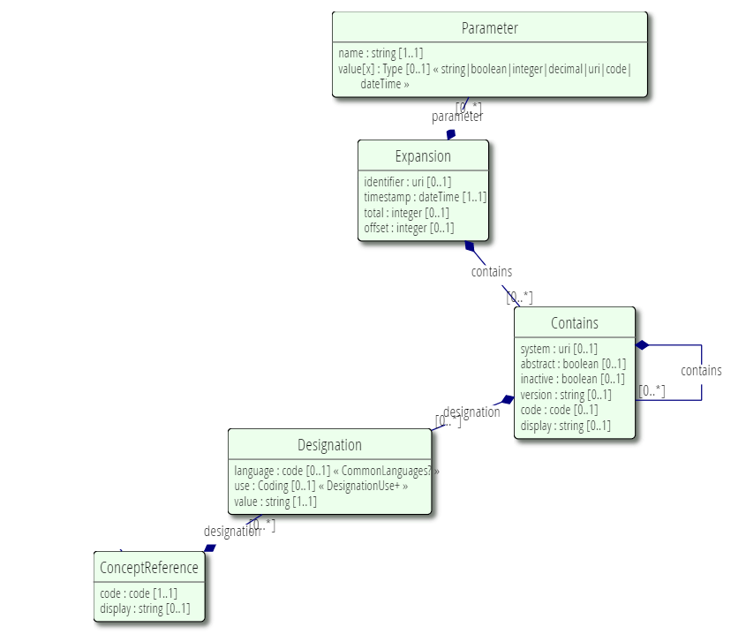
FHIR Value set expansion
Can be given in the ValueSet Resource using the ValueSet.expansion.identifier
Primarily for use by terminology servers etc.

Slide 51
USING TERMINOLOGY IN FHIR

Slide 52
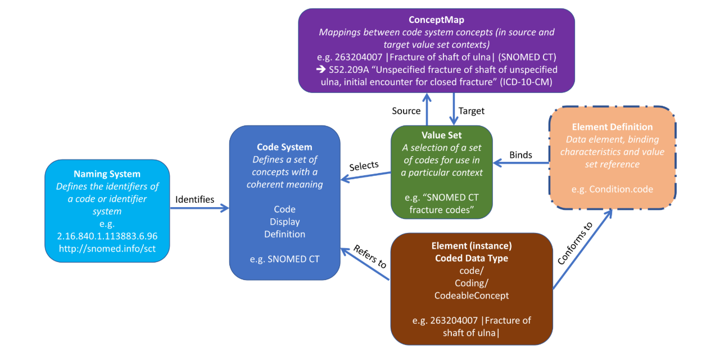
FHIR Terminology Use
ConceptMap: Not covered in this – it’s a major topic in its own right
✓
✓
✓
The things in FHIR that use terminology

Slide 53
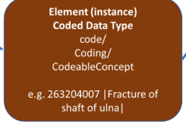
FHIR elements that use terminology
All elements in FHIR specify the datatype to be used
FHIR datatypes may be
Simple / primitive types, which are single elements with a primitive value
General-purpose complex types, which are re-usable clusters of elements
Metadata types: A set of types for use with metadata resources
Special purpose data types - defined elsewhere in the specification for specific usages
Terminology is primarily involved in Simple and General Purpose datatypes

Slide 54
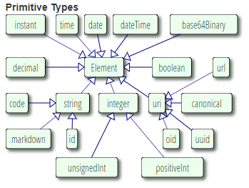
Code
Indicates that the value is taken from a set of controlled strings defined elsewhere
In an instance of a resource, just the “code” (the machine processable string that carries the “unit of thought”) is given; the code system that it is drawn from is implicit (it is in the resource definition itself)

Slide 55
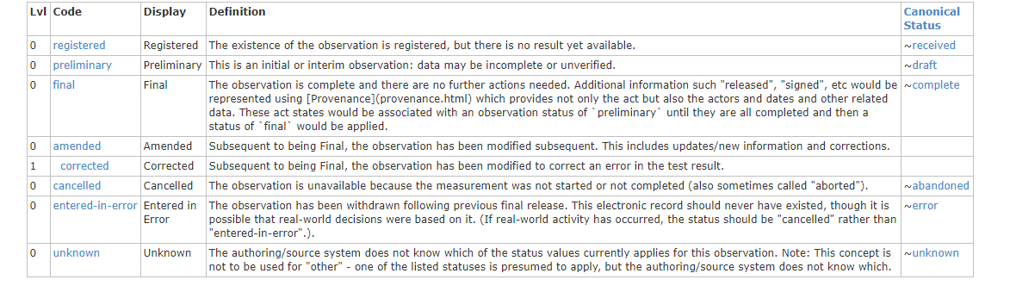
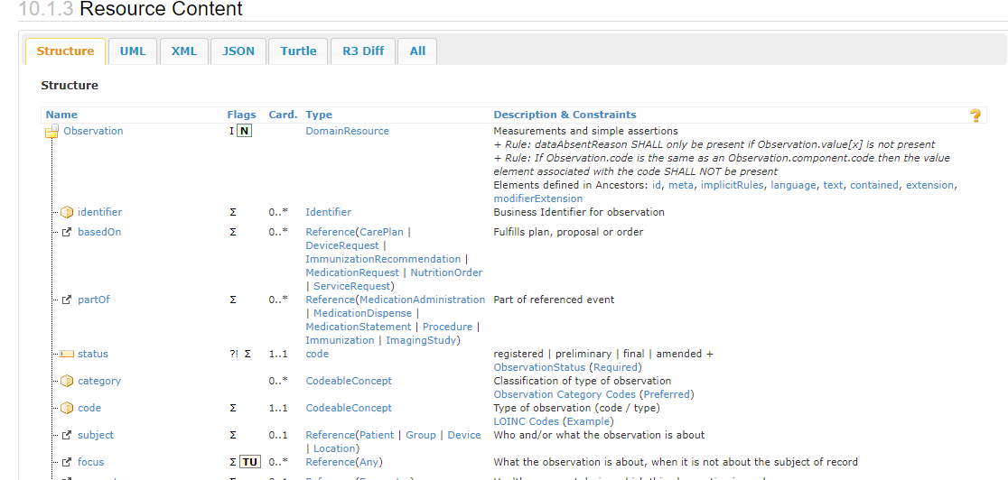
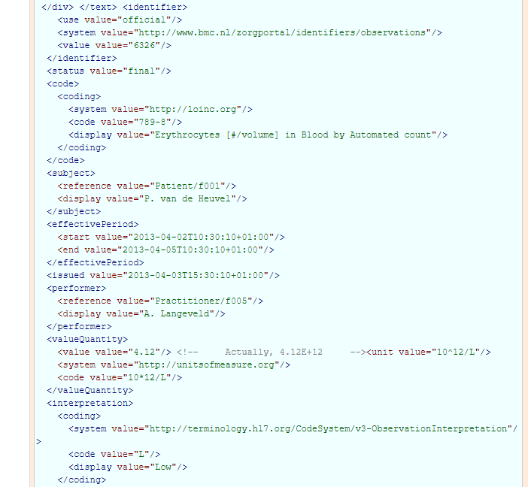
Code example: Observation Status

Slide 56
Using code…in IGs
Simple – it’s all done for you ☺
The code system is identified in FHIR acceptable format
The concepts are defined
Or is it?

Slide 57
Questions to ask when using CODE:
Do the concepts in the code system meet your use case(s) fully?
Can we make a different value set from them? You may not be allowed to
(note the confusion here between code system and value set in the spec)
Who is responsible for the code system/value set? Is it likely to change? Is this OK for your business use case(s)? How can you monitor this?

Slide 58
If you have concerns in using “code”?
“Code” is not something that can easily be changed through implementation guidance directly
You can, of course, add “an extension”
There is supposed to be “no stigma associated with the use of extensions…..”
Or, you will need to work through the FHIR community and processes to suggest change
That may not be “fast” ☹

Slide 59
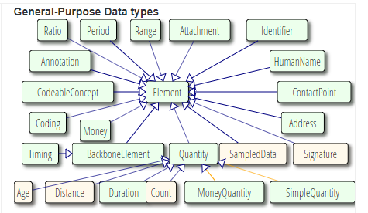
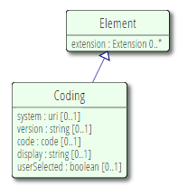
Coding
a representation of a defined concept using a symbol from a defined code system

Slide 60
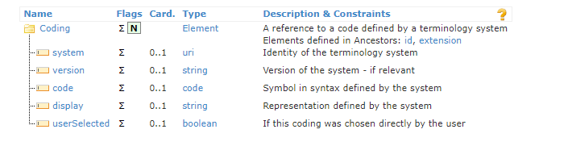
Coding
“Symbol” is a bit ambiguous here; it is the machine-processable string for the concept; similarly “Representation” – it’s a human-readable term (note, it is primarily designed to carry text, not a symbol, as this is string (unless you can get the symbol in Unicode)
And “code” here is not easily reconciled to “code” as the simple datatype – it can be, but the recursion is a little challenging…to do with the “implicitness” of the code system to be referenced

Slide 61
Coding: limitations and [no] example
Can be bound to a value set
All attributes are optional
Not found used as a datatype in its own right in a resource specification….so no actual examples
And the examples in the FHIR spec don’t appear to be correct….or at least not obviously correct

Slide 62
CodeableConcept
Used when a coded concept from a code system is usual, but also allows for provision of text
Can (should!) be bound to a value set

Slide 63
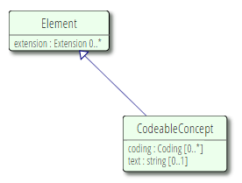
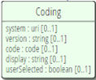
CodeableConcept - detail
Re-uses the Coding datatype and adds in a text string
The coding datatype can be used many times [0..*] so the concept (data/unit of thought) can be expressed using more than one code system

Slide 64
Value set binding
“Binding” is the term used to describe providing a value set for a coded artefact (element)
The degree to which any implementation must use the value set specified is managed by the binding “strength”
FHIR has four binding strengths

Slide 65
FHIR Binding strengths
REQUIRED: To be conformant, the concept in this element SHALL be from the specified value set
EXTENSIBLE: To be conformant, the concept in this element SHALL be from the specified value set if any of the codes within the value set can apply to the concept being communicated. If the value set does not cover the concept (based on human review), alternate codings (or, data type allowing, text) may be included instead
PREFERRED: Instances are encouraged to draw from the specified codes for interoperability purposes but are not required to do so to be considered conformant
EXAMPLE: Instances are not expected or even encouraged to draw from the specified value set. The value set merely provides examples of the types of concepts intended to be included

Slide 66
Binding “Rules”
Specified in 4.1.5 of the FHIR spec [https://www.hl7.org/fhir/terminologies.html]
These are detailed patterns for implementation, in an “if-then” pattern e.g.: <<IF “required” is used with CodeableConcept THEN
at least one Coding element SHALL be present AND
one of the Coding values SHALL be from the specified value set>>
It may be helpful to remind implementers of these rules at the start of an IG so that the actual implementations do obey them in their use of the value set(s) that have been bound

Slide 67
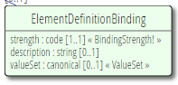
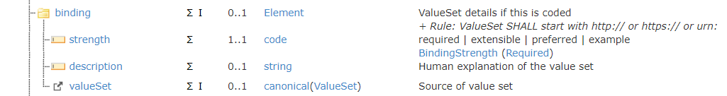
Binding Process/Syntax
Occurs in “Element Definition” – the metadata of any element in a resource (as in ISO 11179)*
* Remember: one person’s data is another person’s metadata – it all depends on perspective and use case

Slide 68
What binding should be used in IGs?
Depends on the datatype
Code, Coding or CodeableConcept
Advantages of ‘strong’ binding
Clarity, value for analysis especially in different contexts
Disadvantages of ‘strong’ binding
Restriction, may “warp” the data

Slide 69
FHIR Terminology Use (II)
ConceptMap: Not covered in this – it’s a major topic in its own right
✓
✓
✓
✓
The things in FHIR that use terminology
✓

Slide 70
Considerations for Code system selection

Slide 71
The “Cimino Desiderata”
Desiderata for Controlled Medical Vocabularies in the Twenty-first Century Methods of Informatics in Medicine, 1998;37:394-403
Content, content, content
Multiple granularities
Evolve gracefully
Concept orientation
Formal definitions
Concept permanence
Representation of context
Non-semantic concept identifier
Polyhierarchy
Multiple consistent views

Slide 72
Content, content, content
Although the Codeable Concept datatype allows for text, and the Code datatype gives no choice for code system, this is possibly the most important consideration
Does the code system truly provide the concepts (the “units of thought”) that express the data that you want to communicate in this coded element?

Slide 73
Multiple Granularities
Are good – allow expression of more detail
Important to have balance – especially in a value set

Slide 74

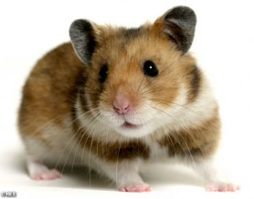


Imagine the element “family pet”
Concepts in the value set are things like “hamster”, “guinea pig”, “rabbit”,
taken from a “small animals” code system
But for dogs, the value set takes concepts from the “Kennel Club Breeds” code system with concepts like “standard poodle”, “golden retriever”, “King Charles spaniel”….
So the value set contains concepts from the two code systems
“hamster”, “guinea pig”, “rabbit”, “cat”, “standard poodle”, “golden retriever”, “Cavalier King Charles spaniel”….
This gives a mixed granularity – there are breeds of guinea pigs too!

Slide 75
Evolve Gracefully
The terminology has a clear policy for change: additions and retirements
What if you need additional content?
Check it is within the scope of the code system (its description of itself)
If it’s not, then you need a different code system
Is this likely to be a routine change that you will see in the next version (e.g. if it covers a domain that changes rapidly, such as medicines)?
What does the code system say about change? (See HTA pages on Confluence for global code systems)
Contact the HTA regarding a possible change request (or the IPS team if in that domain)
For national terminologies, use the national process for the HL7 Affiliate

Slide 76
Concept orientation and formal definition
No redundancy, No ambiguity
Semantic clarity
Achieved by
Definition by text
Editorial policy and strict maintenance
Definition by model (relationships and defining attributes) and tooling
Also has editorial policy
This is much harder than it would appear, especially in large terminologies. It takes significant amounts of expertise, both in the domain and in terminology management.
Notes:
CDISC terminology fails to do this well (for example)

Slide 77
Reject “NEC” (not elsewhere classified)
And “NOS” (not otherwise specified)
No “bucket concepts”
Why?
The meaning of these concepts changes over time
If you must use a code system that has these (and they are reducing) you may wish to removed them from your value set
NB: They are not always obvious – see ATC and the “combination concepts”

Slide 78

Representation of Context
The ever present debate ☺
How much “context” to have in the terminology as opposed to how much is in the information model
Try to avoid the “double positive” – it causes confusion and reduces the ability to safely share and reuse data
Family history: value = family history of asthma
Choose the value set carefully

Slide 79
Common Context Issues
“History of” – using the Condition resource implies that this sort of context will come from the terminology
“Family history of” – may go in Condition resource, or if specified to an individual, in the FamilyMemberHistory resource – in which case the context will NOT come from the terminology
“Allergy to” – similar issues in the AllergyIntolerance resource which allows concepts both with context and without (currently)

Slide 80

Context: Negation
Remains a nightmare
Why?
Is a group working on this explicitly
Personal recommendation: use the terminology exclusively BUT may not have all the concepts available to do that
See https://studylib.net/doc/7026518/position-paper-on-the-use-of-negation Position Paper on the use of Negation Kalra/James

Slide 81
Concept permanence
Once released, a concept’s meaning does not change
Without this, analysis and re-use are severely compromised
Be familiar with the terminology’s editorial guidance on this – it should be in the public domain

Slide 82


Non-semantic concept identifier
It’s just too easy to make mistakes otherwise
Avoid leading zeros
Make sure that the string can manage the code (64bit int for SNOMED CT)
Code value = TATT

Slide 83
Polyhierarchy
The “direct acyclic graph” in subsumption (is_a) relationships in a terminology
Allows multiple parentage – useful for decision support and analysis
Allows concepts to be moved – useful for maintenance
Unlimited hierarchy depth – useful for granularity
No node can be a descendant of itself = acyclicity
Any one node always has the same descendants, wherever it appears

Slide 84
Polyhierarchy – in value sets
Make sure, especially for intensionally defined value sets using the “all concepts that are children of…” type expression, that you do not include concepts that you did not intend, because of their “multiple parents”

Slide 85
Implications of the Cimino Desiderata
The organisation providing the code system needs to have significant terminology expertise
The organisation needs to be stable and committed to “the long game” ☺

Slide 86
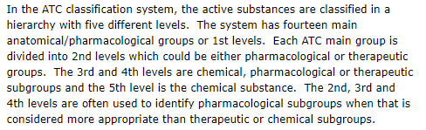
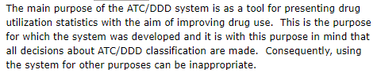
Code system compatibility to the use case
Does the terminology allow the use of its content in the context of the resource?
ATC example: https://www.whocc.no/atc/structure_and_principles/
Should you use ATC as a code system for medication?

Slide 87
Understanding a complex terminology
In SNOMED, for example: “Amoxicillin” – is it@
SCTID: 372687004 OR
SCTID: 27658006 OR
SCTID: 77458009
In LOINC, be sure to be clear about the difference between a test and a substrate (for example)
In a UI, various things can help with this; in IGs this just needs to be managed very carefully
When using a complex terminology, they have significant power but must be used correctly. This requires good domain knowledge, NOT just a quick read of a guide

Slide 88
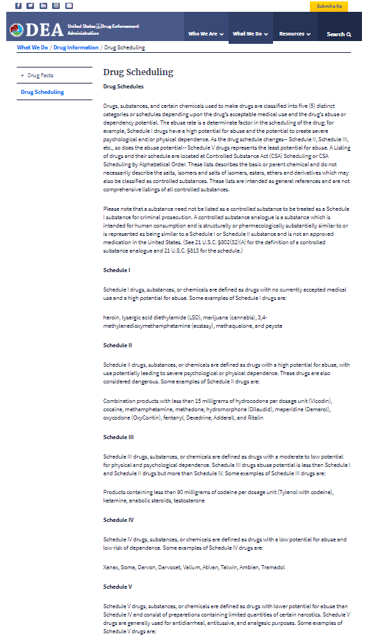
Is the data in a code system?
https://www.dea.gov/drug-scheduling
Why or why not?
What should you do?
Please: use your Vocabulary Facilitator

Slide 89
Describing a medicinal product: Colour
Find me a code system to use…..
RAL colour standard
Pantone colour standard
?? What else
What are your criteria for choice?

Slide 90
Criteria to consider
Content/granularity
Domain/scope/usage statement
Definition of concepts
Availability/licence for use/Ownership & maintenance organisation
National/international use
What has been stated in the exemplar binding in the resource (for CodeableConcept)

Slide 91
Using the FHIR Code System Registry
For the FHIR specified code systems, this is (probably) the source of truth, especially for the CODE datatype
CHECK CAREFULLY that the content meets your requirements and what implications are for the prescribed value sets
For the external code systems, maybe….

Slide 92
Internal or external code system?
Internal code system:
Authored and maintained by some part of the HL7 community
Has positives and negatives……
Control of content
Speed of change (possibly)
Universal Terminology Governance
Domain expertise?
Resources?

Slide 93
Describe “diagnosis”
What are the candidates?
SNOMED CT
ICD 10
MedDRA
……

Slide 94
SNOMED CT
Adheres to the Desiderata
Very good scope for the healthcare domain – particularly for describing the process of care
Highly modelled (in most areas) so needs significant expertise to use well
Good for analysis because of polyhierarchy
Contains “knowledge” as well as concepts
Not all areas are modelled and may not have the quality of other areas
Supports post co-ordination
Requires license for use (even in member nations)
Core will not be nation specific (e.g. for medicines)
If using a national extension, identify it correctly

Slide 95
ICD 10
Adheres to the Desiderata (mostly)
Primary use is morbidity and mortality statistics and analysis – is a “classification”
Has a well used post co-ordination syntax
Scope is description of diseases, conditions and injuries (primarily)
Multi-lingual

Slide 96
MedDRA
Medical Dictionary for Regulatory Activities
Scope – diagnoses, injuries, adverse events, lab tests (qualitative changes)
Usage – coding and particularly adverse event reporting in the regulatory environment
Like ICD10 – it is a hierarchical classification as well as a terminology

Slide 97
See also the HTA Confluence pages
For basic information about external code systems for use in HL7 artefacts

Slide 98
Considerations for VALUE SET Definition

Slide 99
Why bother with value sets?
Why not just reference the code system and let the user have free choice?
Sometimes, an attribute/element may need concepts from more than one code system in order to describe it
A value set can draw content from more than one code system (as described in the CLD)
But be very careful of content overlap

Slide 100



“Allergy to/allergen”
Allergies are typically to
Medicinal substances
Food substances
Complex natural proteins (e.g. pollens) and other substances (e.g. latex)
Although SNOMED CT will cover all of those, it will be at an abstract and generic level (i.e. not the medicines licensed in your jurisdiction); for that there will be national medicinal product terminology….but that probably will not include foods or other allergens
So the value set for a coded concept to describe an allergy to something (i.e. an allergen) is likely to need to draw from more than one code system

Slide 101
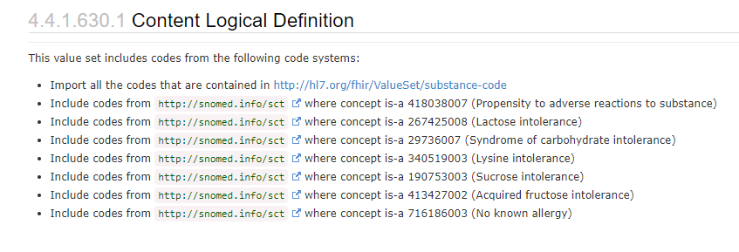
Allergy/Intolerance Resource
The exemplar value set draws from several parts of SNOMED CT:

Slide 102
Value sets and data analysis
The analysis and interpretation of the information that you collect using value set B might be quite different to that which you get if you collected the information using value set A

Slide 103
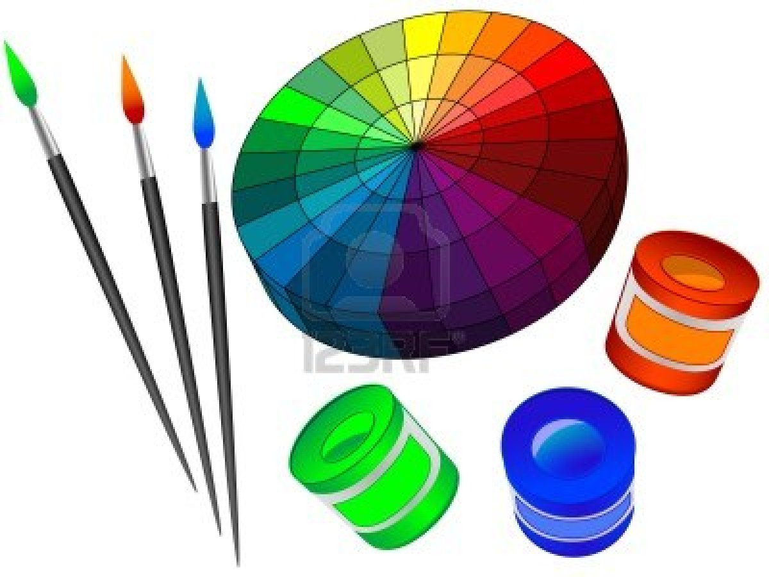
Data Collection:
In two different surveys, 50 people were asked to indicate their favourite colour
In Survey A, 17 people said “blue”
In Survey B , only 4 people said “blue” (R0 G102 B204)
Why the difference?

Slide 104
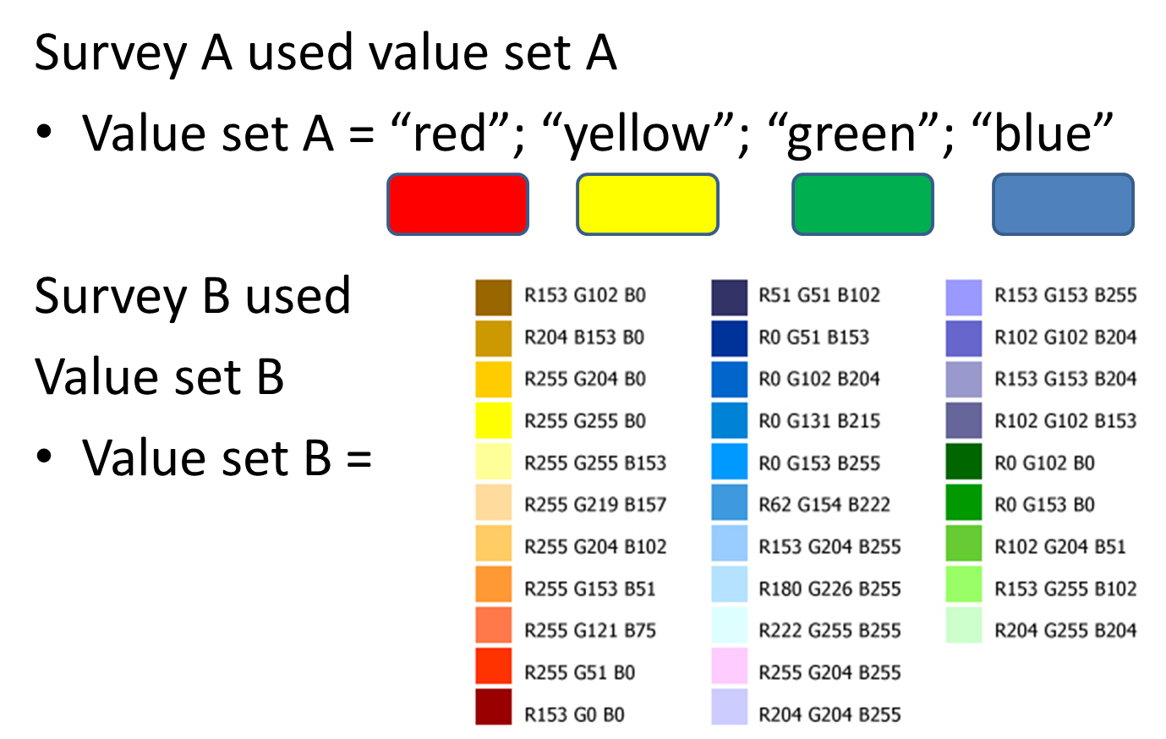
Favourite colour value sets:

Slide 105
Value set considerations
The concept granularity in value sets must be balanced
The value set definition (CLD) is key
Not just for the value set identify itself, but also
For the version of the value set used, especially when that is designed to change over time

Slide 106
Summary and Learning Objectives
Hopefully, now you are/have:
confident of the basic principles of terminology in healthcare to be able to apply it effectively (in implementation guidance for) systems
Concepts, Code systems and Value sets
What they are, how they fit together
How to use and identify/reference them
a working understanding of the considerations for code system selection for implementation guidance – which terminologies to choose and why
a working understanding of the considerations for value set management – the when, how and why of using value sets

Slide 107

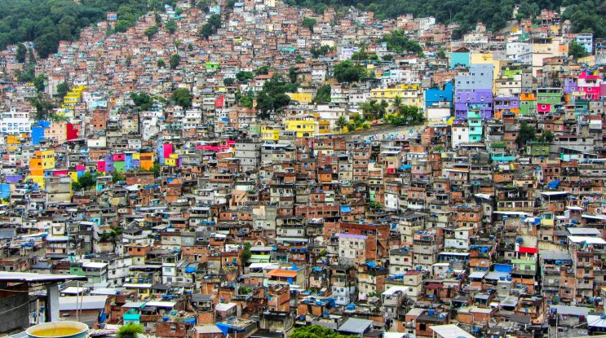
To build anything good for a community requires vision, time, effort, resources and expertise
Building under pressure with minimal resources tends to lead to chaos

Slide 108
Nobody sets out to build badly, it often “just happens” when there is pressure, lack of vision, resource and expertise.
When you build your resources and author your IGs, keep your vision clear and invest sensibly. Use terminology wisely and it will serve you well ☺
THANK YOU!

